Slide 1
ORNAMENTAL TREES

Slide 2
Ornamental Trees
Ornamental plants are the plants that are grown for decorative purposes in gardens and landscape design projects , as houseplants, cut flowers and specimen display. Some examples of ornamental trees include Bauhinia, Butea monosperma, Ceiba speciosa, Acasia, Casuarina, grevillea, Alstonia, Magnolia

Slide 3
ADVANTAGES OF GROWING ORNAMENTAL TREES
Provide a cooling shade in the scorching heat of summers
Ornamental trees with fragrant flowers fill the air with peculiar aroma
Have positive effect on microclimate of areas of big cities
Purify the environment by filtering pollutants, absorbing CO2 and by releasing oxygen
Provide a variety of colors , forms , textures and patterns in our surroundings

Slide 4
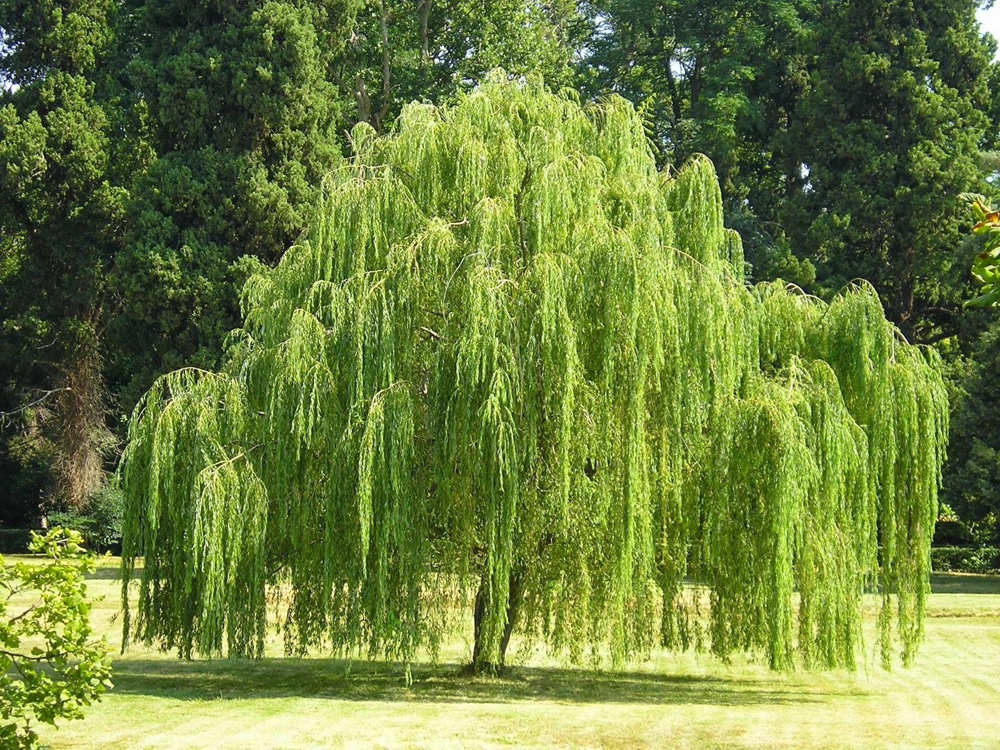
Weeping willow
Botanical Name: Salix babylonica
Family: Salicaceae
Origin : China
Flowering season : Insignificant
Flower color : Greenish-white
Grown for its beautiful canopy with long drooping branches. Suitable for low hills.
It is used to treat mastitis, toothaches, and scalds.

Slide 5
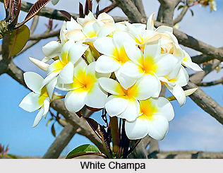
Golden Champa
Botanical Name: Magnolia champaca
Family: Magnoliaceae
Origin : Himalayas
Flowering season :
April-May, Sep-October
Flower color : Golden
Grown for its highly fragrant flowers and shade it is propagated through seeds and layering.
They are primarily used for worship, especially in India

Slide 6
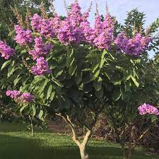
Pride of India, Jarul
Botanical Name: Lagerstroema speciose
Family: Lythraceae
Origin : India, Malaysia, Srilanka, China
Flowering season : April-May
Flower color : Purple, Mauve
Leaves turn coppery in February – March and give a magnificent look.
It is propagated through seeds.
Used to lower blood sugar in the body.
Recommended for kidney, bladder problems and hypertension

Slide 7
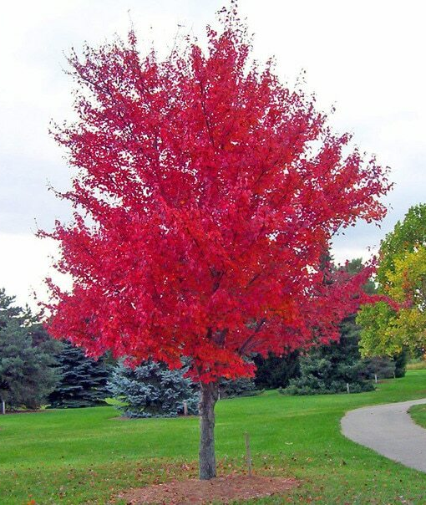
Red Mapple Tree
Botanical Name: Acer rubrum
Family: Sapindaceae
Origin : Eastern and central North America
Flowering season : Autumn
Flower color : Red
Produces red clusters of small flowers winter
to spring . Yields twin seeds bound at their
tips to a long drooping stems.
The bark has astringent properties and has been used as an application for sore eyes.

Slide 8
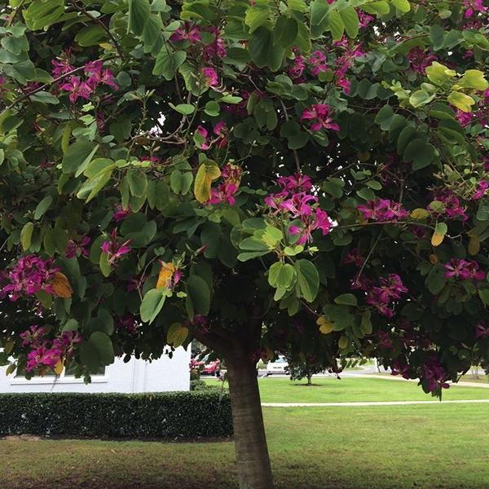
Butterfly Tree, Purple Bauhinia
Botanical Name: Bauhinia purpurea
Family: Fabaceae
Origin : India , Myanmar , China
Flowering season : Autumn
Flower color : Rosy Purple , Deep Pink
The young leaves and flowers of Bauhinia purpurea are edible
Various parts of the plant are also used in decoctions to treat fever and stomach ailments

Slide 9
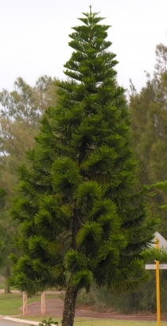
Christmas tree
Botanical Name: Araucaria columnaris
Family: Araucariaceae
Origin : North east of Australia ,
New Caledonia (USA)
Plant Height: Upto 60 m
Grown for its beautiful pyramidal shape and leaves . Propagated through seeds.
It has anti-inflammatory properties.

Slide 10
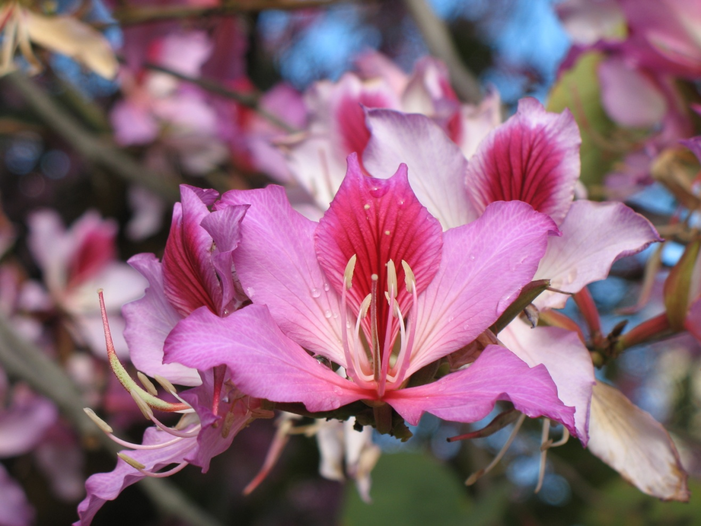
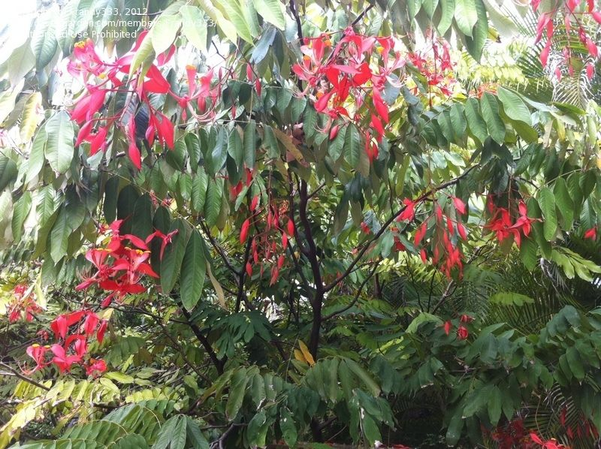
Orchid Tree, Pride of Burma
Botanical Name: Amherstia nobilis
Family: Fabaceae
Origin : India, Myanmar
Flowering season : January- May
Flower color : vermilion colored tipped with yellow
It is propagated through seeds and
layering

Slide 11
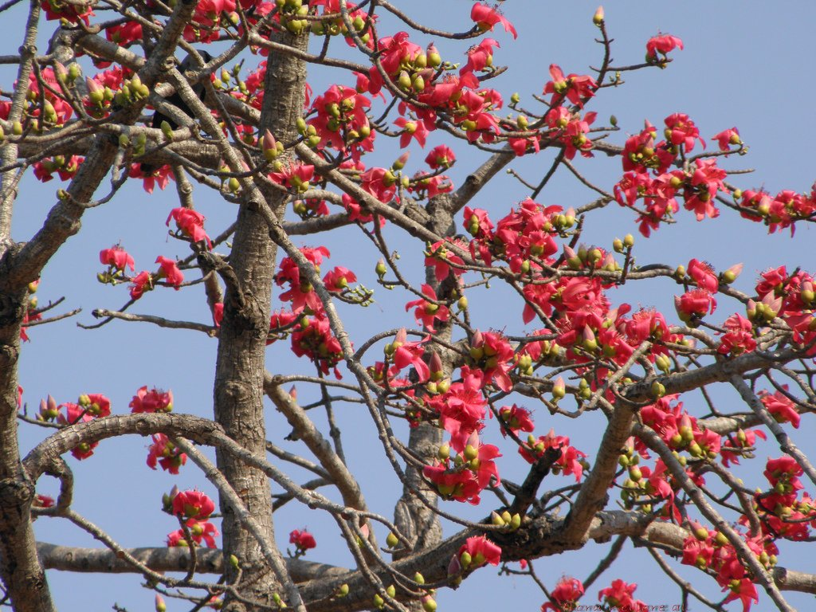
Silk Cotton Tree, Kapok Tree
Botanical Name: Bombax ceiba
Family: Malvaceae
Origin : India , Malaysia , China
Flowering season : Jan.- Feb.
Flower color : Red , orange , Yellow
              It bears flowers when it sheds all the leaves .
              The cotton which comes from the tree is used to make pillows, quilts, sofas, etc.
              The wood part is used in making match sticks

Slide 12
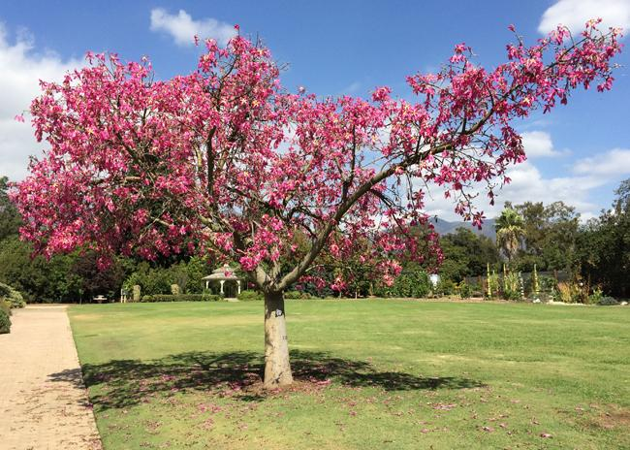
Silk Floss Tree
Botanical Name: Ceiba speciose
Family: Malvaceae
Origin : Brazil and Argentina
Flowering season :
October-November
Flower color : Pink with creamish –
white color
              It is propagated through seeds.
              The seed floss is used as a stuffing material in pillows, cushions etc.

Slide 13
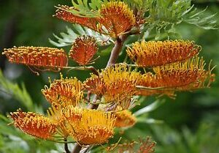
Silver Oak Tree, Australian Silk
Botanical Name: Grevillea robusta
Family: Proteaceae
Origin : Australia
Flowering season :
April-May
Flower color : Golden yellow,
Orange
Silver oak is a medium quality timber extensively used for joinery and furniture,
              It is propagated through seeds.

Slide 14
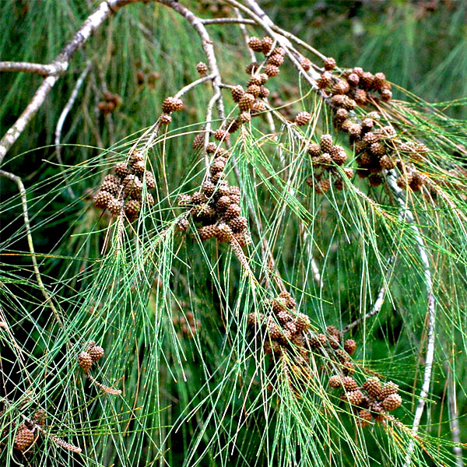
Whistling pine, Casuarina
Botanical Name: Casuarina equisetifolia
Family: Casuarinaceae
Origin : Australia
Plant height : 20-40 m
Suitable for growing in hotter and
drier areas.
The wood of this tree is used for shingles, fencing, and is said to make excellent hot-burning firewood.

Slide 15
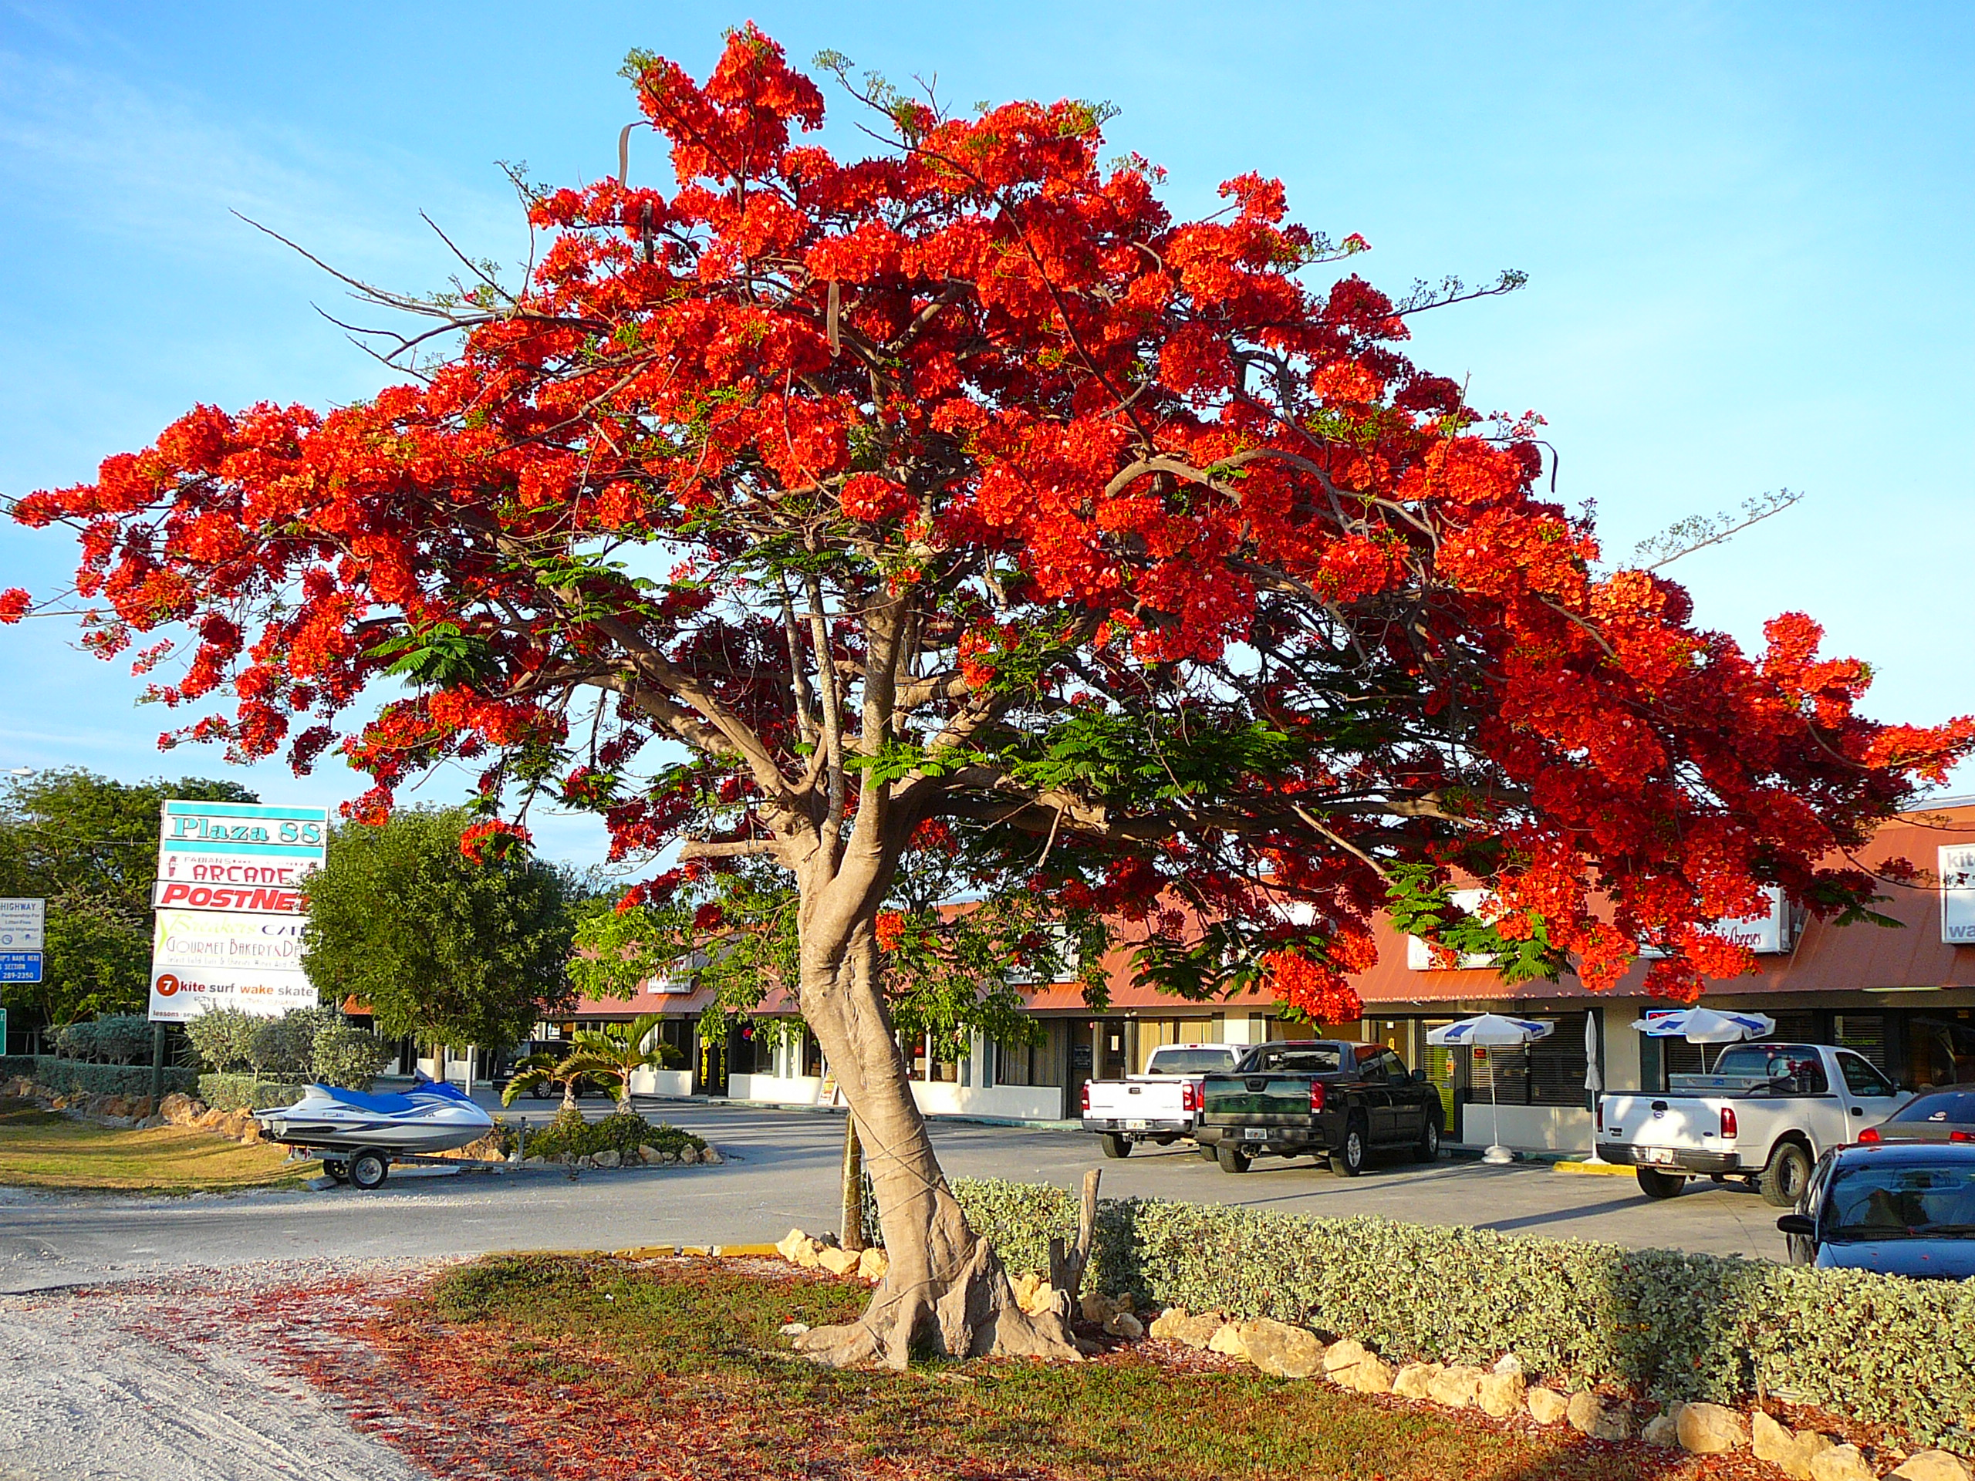
Flame Tree, Gulmohar
Botanical Name: Delonix regia
Family: Fabaceae
Origin : Medagascar
Flowering season :
May-June
Flower color : Orange-Red
              Elegant wide spreading tree with umbrella-like canopy that can be wider than its height .
It has been used in various ailments such as chronic fever, inflammation, arthritis, piles, boils, pyorrhea, scorpion bite, bronchitis and asthma.

Slide 16
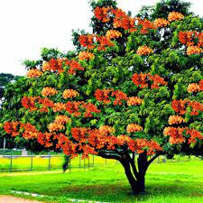
Sorrowless Tree, Sita Ashok
Botanical Name: Saraca asoca
Family: Fabaceae
Origin : India , Malaysia
Flowering season : Summer
Flower color : Red-Orange
              It is a beautiful evergreen medicinal tree . It is propagated through seeds.
              The bark is also useful in dyspepsia, fever, and burning sensation.

Slide 17
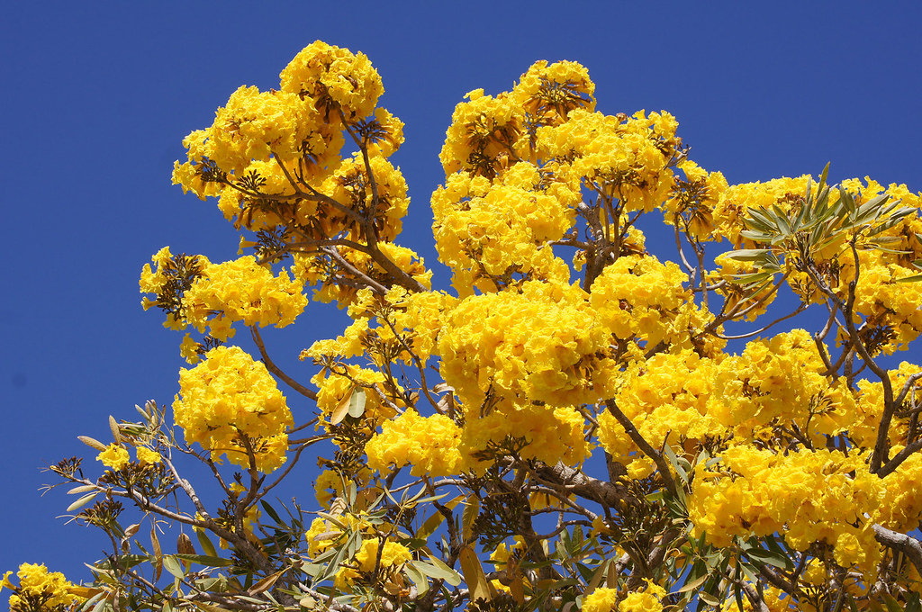
Silver trumpet Tree
Botanical Name: Tabebuia aurea
Family: Bignoniaceae
Origin : South America
Flowering season : March-April
Flower color : Bright Yellow
              Dense terminal clusters of bright yellow funnel-shaped flowers in leafless conditions appear very pretty during early summer.
Its roots produce a soft and spongy wood that is used for floats, razor strops, and the inner soles of shoes

Slide 18
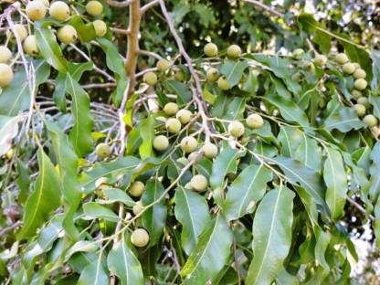
Lucky beanTree, Putranjiva
Botanical Name: Putranjiva roxburghii
Family: Putranjivaceae
Origin : India , Myanmar , Srilanka
Flowering season : March-April
Flower color : LightYellow
              Grown as an avenue, shade and sacred plant . Propagated through seeds .
Putranjiva roxburgii is an ayurvedic herb used for the treatment of eye disorders, burning sensation, elephantiasis, difficulty in micturition, azoospermia and habitual abortions.

Slide 19
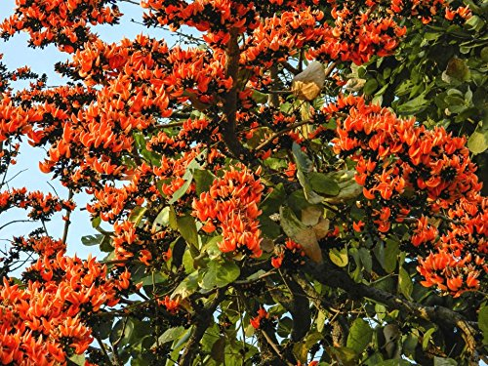
Palash, Flame of forest
Botanical Name: Butea monosperma
Family: Fabaceae
Origin : India , Burma, China
Flowering season : Early Summer
Flower color : Scarlet-orange
              Palash is mainly used to get rid of worms from the stomach. It can be used to manage diarrhoea as it has antimicrobial properties. It also helps to manage liver disorders due to its antioxidant properties.

Slide 20
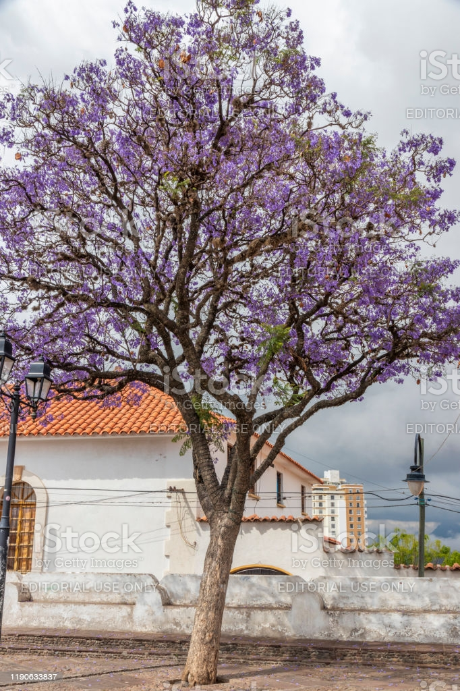
Neeli Gulmohar, Blue Jacaranda
Botanical Name: Jacranda mimosifolia
Family: bignoniaceae
Origin : Brazil
Flowering season : March-May
Flower color : Blue, bell shaped
              Bears flowers when it sheds all the leaves .
It is used to treat venereal infections, gastrointestinal disorders, colds and rheumatism.

Slide 21
Sources:
Book on Gardening and Floriculture, by S. Dinesh & Co.
Internet recourses for plant images

Slide 22


